Slide 1
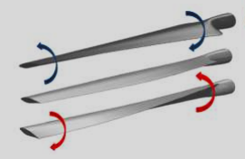
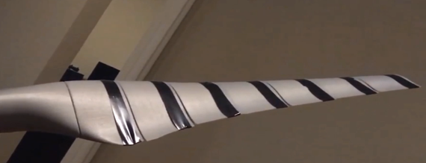
Overall summary
Atrevida Science / AFWERX Phase I Topic AF21A-TCSO1 (FX21A-TCSO1-0218)
Technical merit
Smart and active wind turbine blades with advanced control capabilities adapt to varying wind conditions, increase energy production, and shed deleterious loads (reduce failures)
Actively variable twist wings expand flight envelope for aircraft and reduce noise and vibration
AMB™ commercialization supported by
broad customer discovery
suite of computational simulations
three completed prototypes
ongoing wind tunnel investigations
1
Technical abstract
Atrevida Science is
developing actuated morphing blade (AMB™) to improve efficiency and reduce loading (less failures) on wind turbines
exploring potential value propositions for AF customers such as reducing drag and fuel consumption
Impact: improve efficiency 3-5% and enable scaling of blades for 15MW turbines
Team
Team members
decade of expertise in actuated morphing blade design and control
combined 50 years industrial experience including power generation
business development advisors and OEM insiders to accelerate commercialization
Atrevida Science
AMB™ design concept
Overview
Develop test setup to
measure aerodynamic response of actuated variable twist blade
visualize flow around actuated variable twist blade experimentally (by particle tracking) to reduce drag and fuel consumption for AF warfighter
Commercialization
Atrevida Science will
collect field data
develop functional prototype with industrial strategic partners
license AMB™ technology to OEMs
Actuation packaging prototype of AMB™

